Slide 1
Vehicle Recognition App Team Terminator

Slide 2
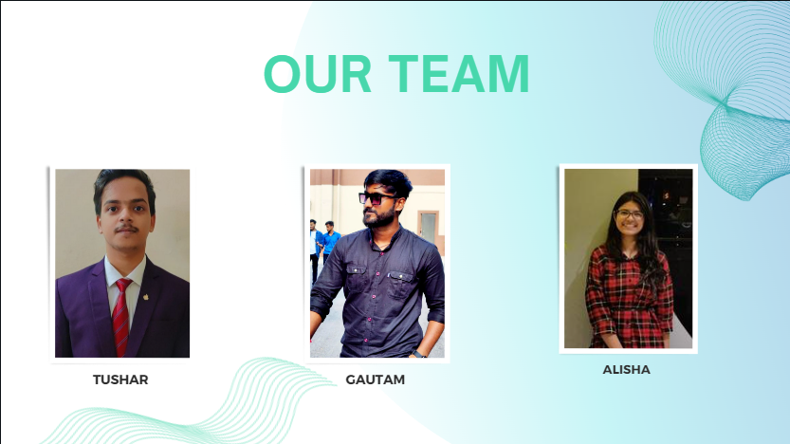

Slide 3
Content:-
Introduction
Prototype Overview
Our Services
Video Stream Parsing
Technology Stack
Architecture
Results
Estimated Cost for Full Implementation
To enhance your prototype into a full-blown application
Conclusion

Slide 4
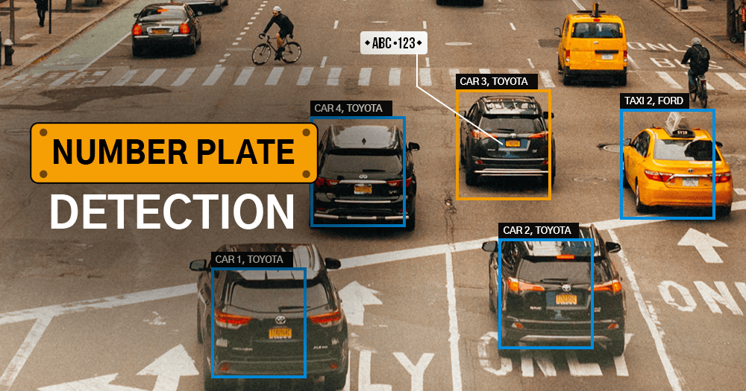
Introduction:-
Welcome to our presentation on the Vehicle Recognition App.
Objective:-
The primary goal of this project is to develop a cutting-edge application prototype capable of efficiently processing a recorded video stream to scan and recognize vehicle number plates.
It will further store these registration numbers in a secure database.

Slide 5
Prototype Overview:-
Frontend and Backend
The application is divided into two key components: the frontend and the backend.
Frontend:- This component, powered by Angular, serves as the user interface, offering an intuitive and user-friendly experience.
Backend:- Driven by Python, the backend is the engine that powers the application, handling core functionalities such as video processing and data management.
Database Integration:-
MongoDB is integrated as the database management system for our prototype.
It plays a critical role in storing, retrieving, and managing registration data, ensuring that all information is organized and accessible.

Slide 6
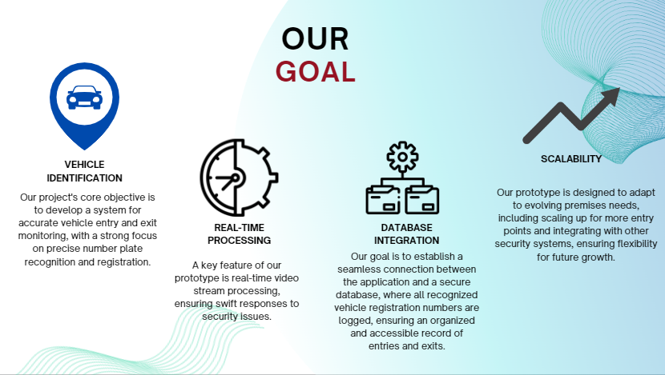

Slide 7
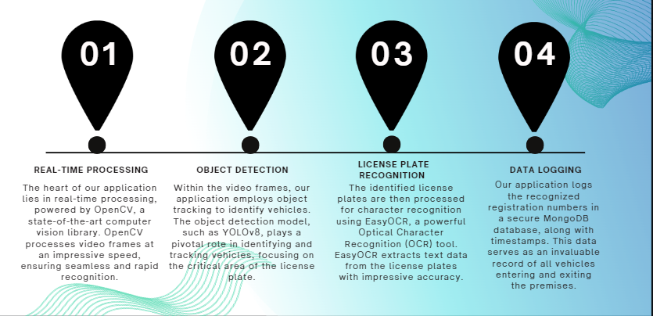
Video Stream Parsing:-
Functioning of our Prototype

Slide 8
Technology Stack:-
Video Processing and Recognition
OpenCV :OpenCV, a powerful open-source computer vision library, is at the core of our video processing. It allows for real-time analysis of video frames.
EasyOCR: For license plate recognition, we utilize EasyOCR, an advanced Optical Character Recognition (OCR) tool. It extracts text data from license plates with high accuracy.
YOLOv8: We integrate YOLOv8, a state-of-the-art object detection model, for identifying and tracking vehicles within video frames. This plays a pivotal role in the accurate recognition of license plates.
Frontend
Angular: The frontend of our application is developed using the Angular framework. It provides a user-friendly interface for interacting with the app.
Backend
Python: The backend, written in Python, is responsible for processing video streams, recognizing license plates, and managing data.
Database
MongoDB: Our choice for the database management system is MongoDB, a NoSQL database. It offers flexibility and scalability, ensuring the secure storage of recognized registration numbers and timestamps.

Slide 9
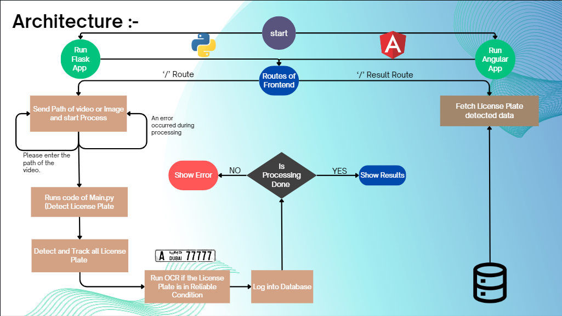

Slide 10
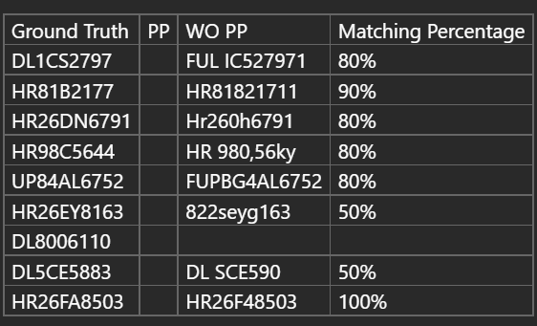


Results:-
Our Vehicle Recognition App has undergone rigorous accuracy testing to assess its performance. The results indicate an impressive accuracy rate of 75%-80%in recognizing license plates.
This high level of accuracy ensures that the application reliably identifies vehicles and records their registration numbers, contributing significantly to our access management and security efforts.

Slide 11
Estimated Cost for Full Implementation:-
Resources:
Frontend Engineer
DevOps for Cloud Deployment
Backend and AI Specialists
Quality Assurance (QA) for Testing
Training: Training programs for staff to effectively operate and manage the application.
Security: Investments in cybersecurity measures to safeguard data and the application against potential threats.
Scaling Infrastructure: Costs associated with scaling infrastructure as the application is expanded to cover more areas and additional features. --
Data Management: Storage costs for managing the ever-growing database of recognized registration numbers.
Environmental Considerations: Expenses for aligning the application with sustainability goals, ensuring it meets environmental standards.
Prototype Utilization:
Leveraging existing prototype for development acceleration.
Scaling:
Implementing multiple webcams in different positions for wider coverage.
Enhancing vehicle recognition for diverse types of vehicles.
Project Timeline:
4 months, equivalent to 8 sprints (2 weeks per sprint).
Cloud Infrastructure:
Additional costs may apply for cloud infrastructure based on the size of target user group.
Post-Implementation Support:
Include 2 weeks of support after full implementation.

Slide 12
To enhance your prototype into a full-blown application:-
User-Friendly Interface: Continuously improve the user interface to make it intuitive and user-friendly for security personnel and administrators. Consider customization options to adapt to the unique needs of different premises.
Mobile Access: Extend the application to mobile platforms to enable security personnel to monitor and manage access remotely, providing flexibility and real-time responsiveness.
Data Analytics: Enhance reporting and analytics capabilities to provide deeper insights into access management, security trends, and operational efficiency. Data-driven decision-making becomes a crucial aspect of the application.
Scalability: Ensure that the application can scale to accommodate a growing number of users, vehicles, and access points. This may involve load balancing, optimizing database performance, enhancing system architecture, and optimizing algorithms to reduce time complexity. By improving algorithm efficiency, the application can process data faster and handle increased loads seamlessly as it scales.
Security: Implement robust security measures, including data encryption, user authentication, and access control, to protect sensitive information and ensure compliance with data privacy regulations.
Integration: Integrate the application with existing systems and infrastructure within the organization, such as access control systems, security cameras, and databases, to create a seamless security ecosystem.

Slide 13
Conclusion:-
The Vehicle Recognition App is poised to revolutionize access management and security.
Real-time processing, object tracking, and license plate recognition enhance efficiency.
Integration with MongoDB ensures reliable data storage.
Future developments include system integration, advanced analytics, and scalability.
We're dedicated to setting new standards in security and access management.

Slide 14
Thank you

